Slide 1
ELUCIDATING DRUG-DRUG INTERACTIONS UNDERLYING DRUG POLYPHARMACY PROFILES
UNIVERSITY OF COPENHAGEN
FACULTY OF HEALTH AND MEDICAL SCIENCES

Slide 2
Project description
First phase -> recollect DDIs information from public databases.
Treat and tidy data -> Linkage network between features
Integrate drugs and DDIs merging datasets.
Stablish a dataset that relates all identifiers.

Slide 3
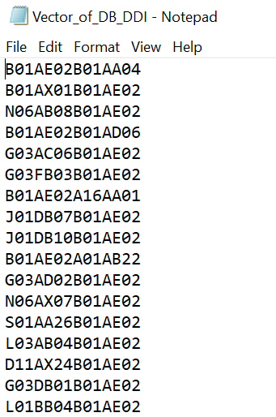
ELABORATION OF UPSETR; ATC treatment
Four different dataset of identifiers
Drugbank to ATC
CUI to ATC
KEGG to ATC
Rxnorm_IDs to CUI
All datasets have incremented the number of interactions with ATC codes.
For each dataset, one txt file with just the DDI
AUTOMATE treatment
For each pair, check which string is bigger.
Order from bigger to smaller
Join string
Eliminate duplicates
Resulting in vectors for posterior plots

Slide 4
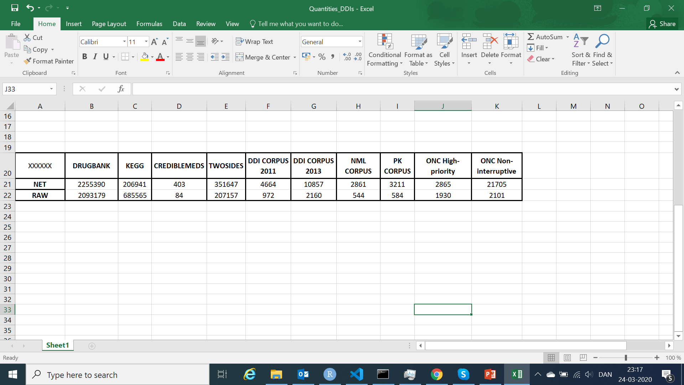
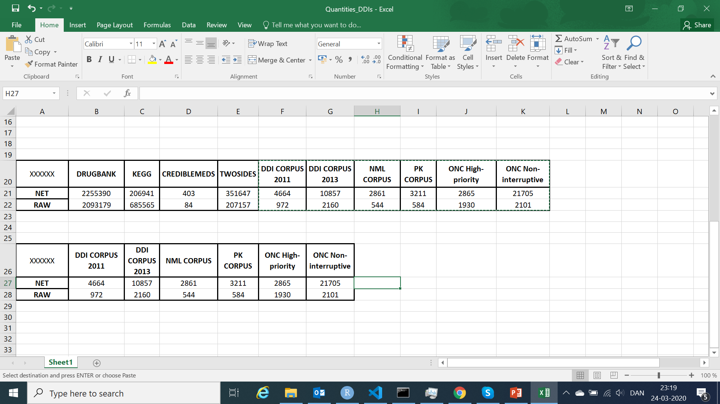
Final VALUES ddis

Slide 5
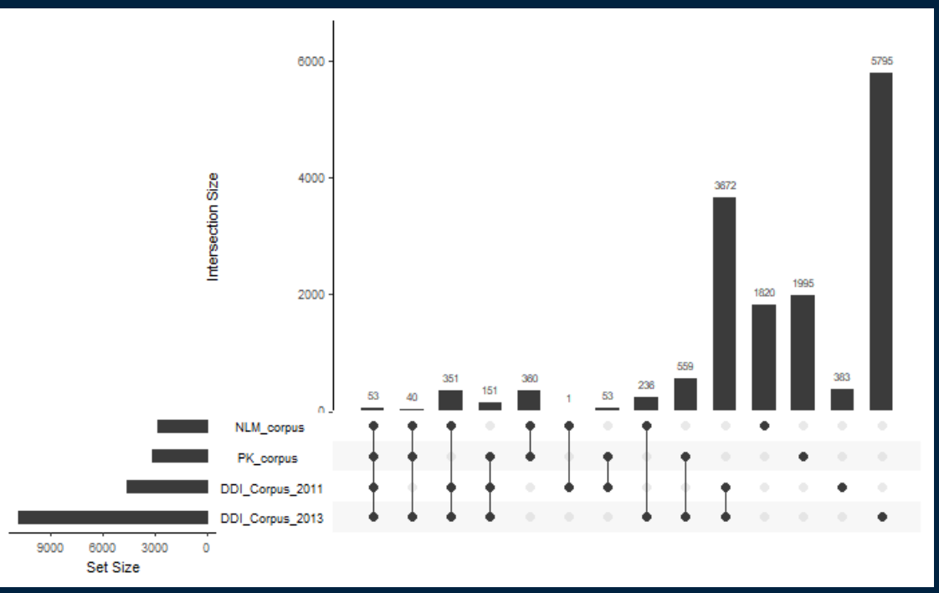
SIGNIFICANT UPSETR PLOTS
CORPUS PLOT
Coverage between 2013-2011 -> 78.7 %

Slide 6
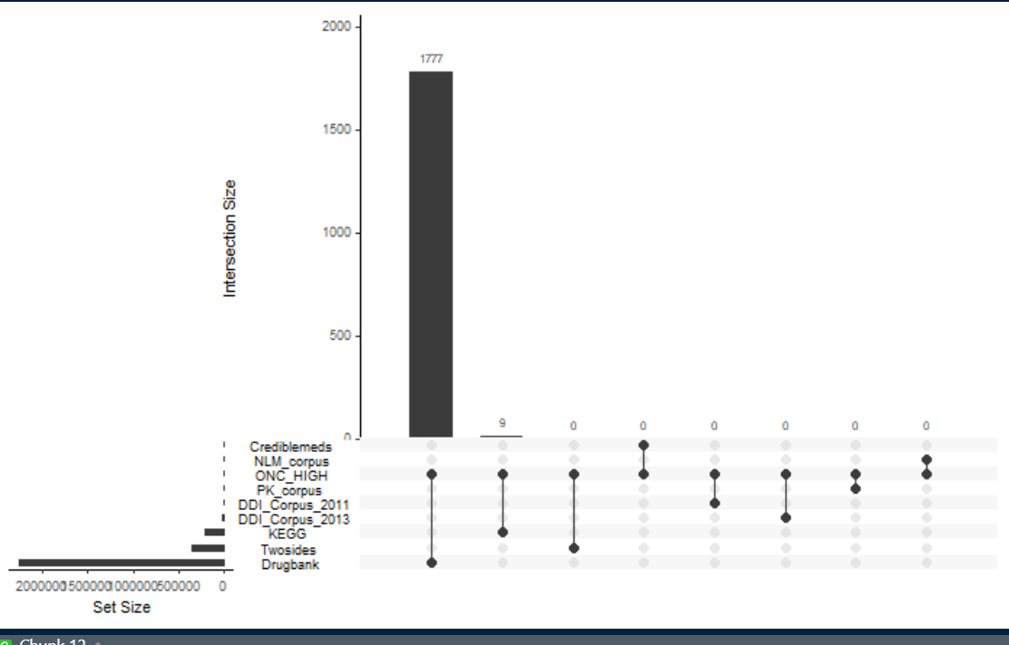
ONC_HIGH PLOT
Coverage Drugbank-ONG_HIGH -> 62%

Slide 7
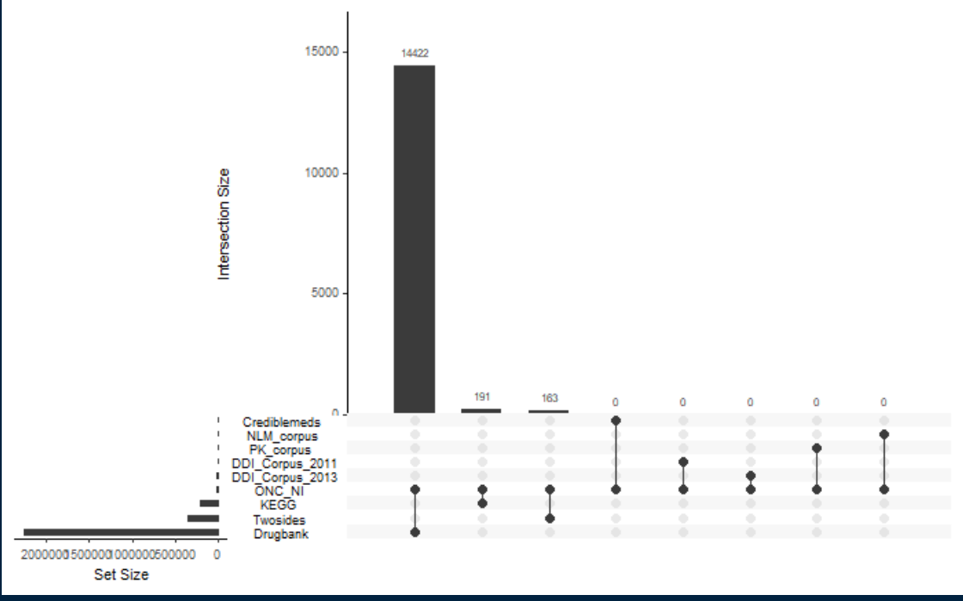
ONC_NON_INTERRUPTIVE
Coverage Drugbank-ONG_NI -> 66.5%

Slide 8
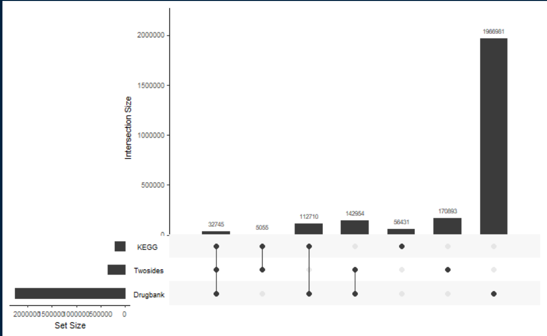
Drugbank, KEGG, Twosides
Coverage Drugbank-Twosides -> 40.65%
Coverage Drugbank-KEGG -> 54.46%

Slide 9
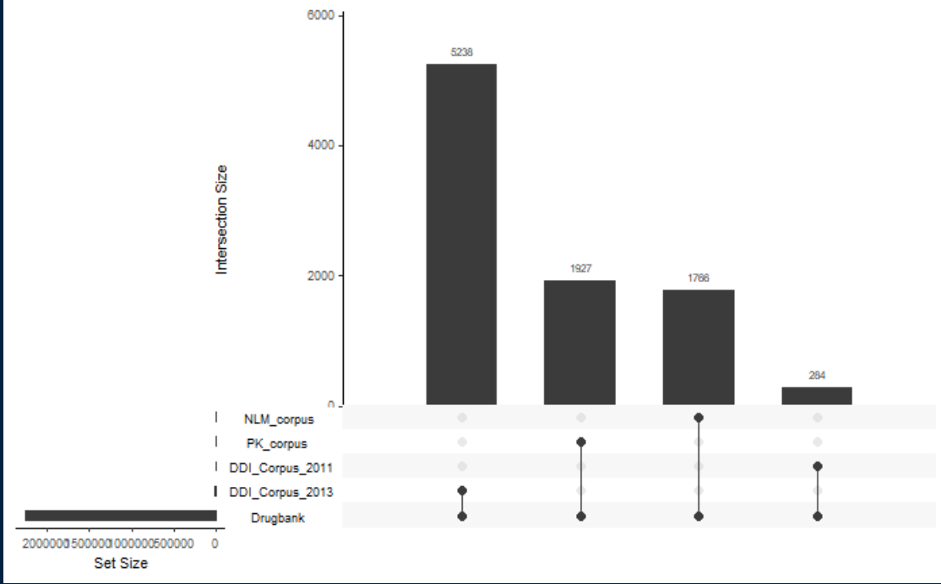
Drugbank
Coverage Drugbank - Corpus_2011 -> 5.65 %
Coverage Drugbank – Corpus_2013 -> 48.24 %
Coverage Drugbank – NLM_corpus -> 61.72 %
Coverage Drugbank – PK_corpus -> 60 %

Slide 10
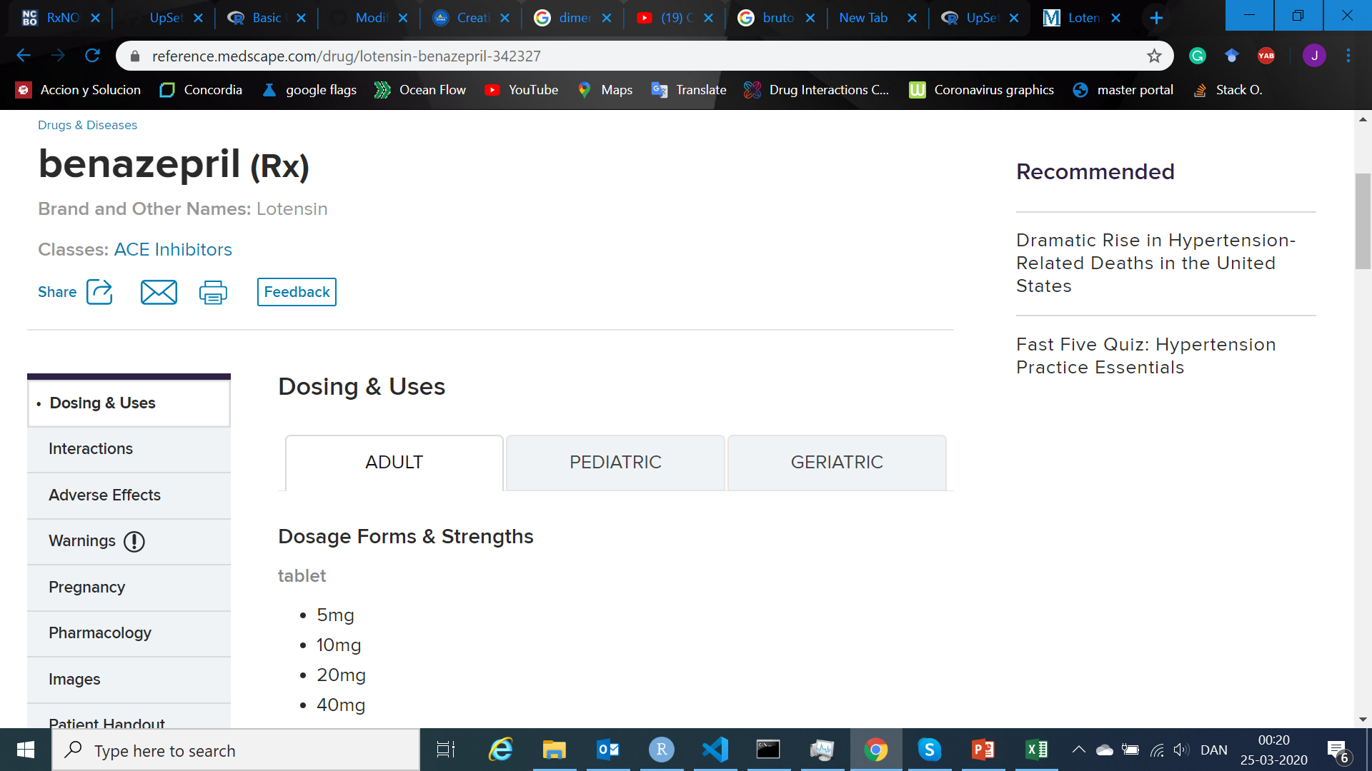
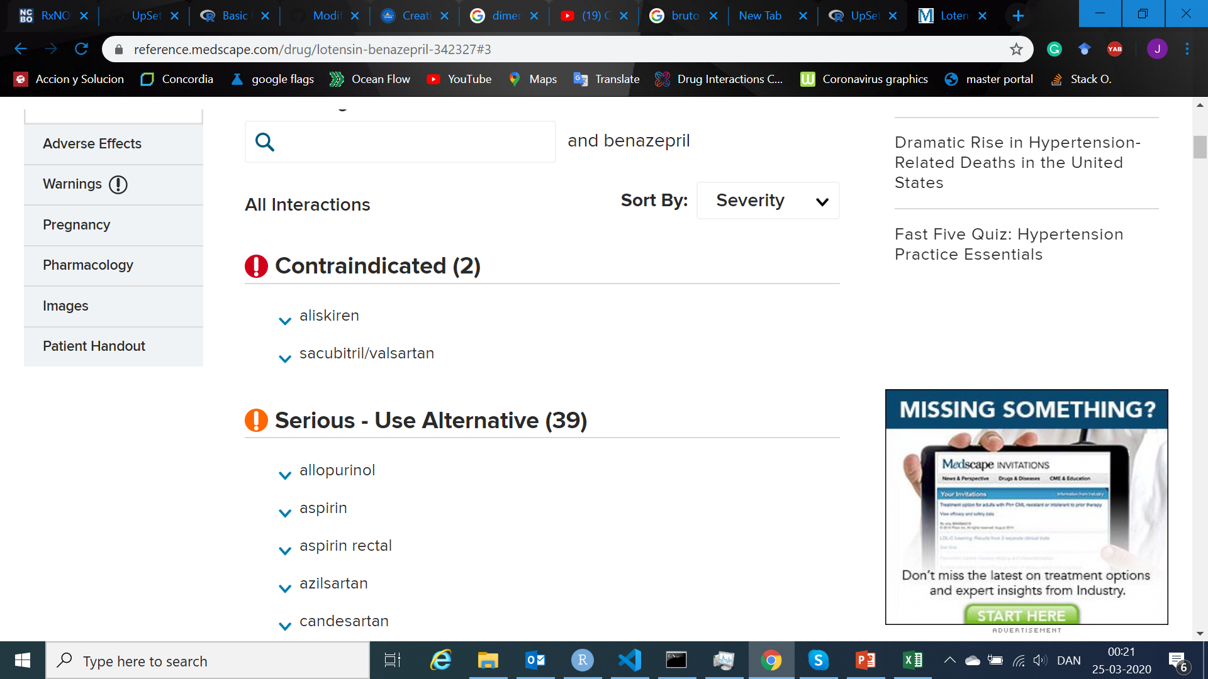
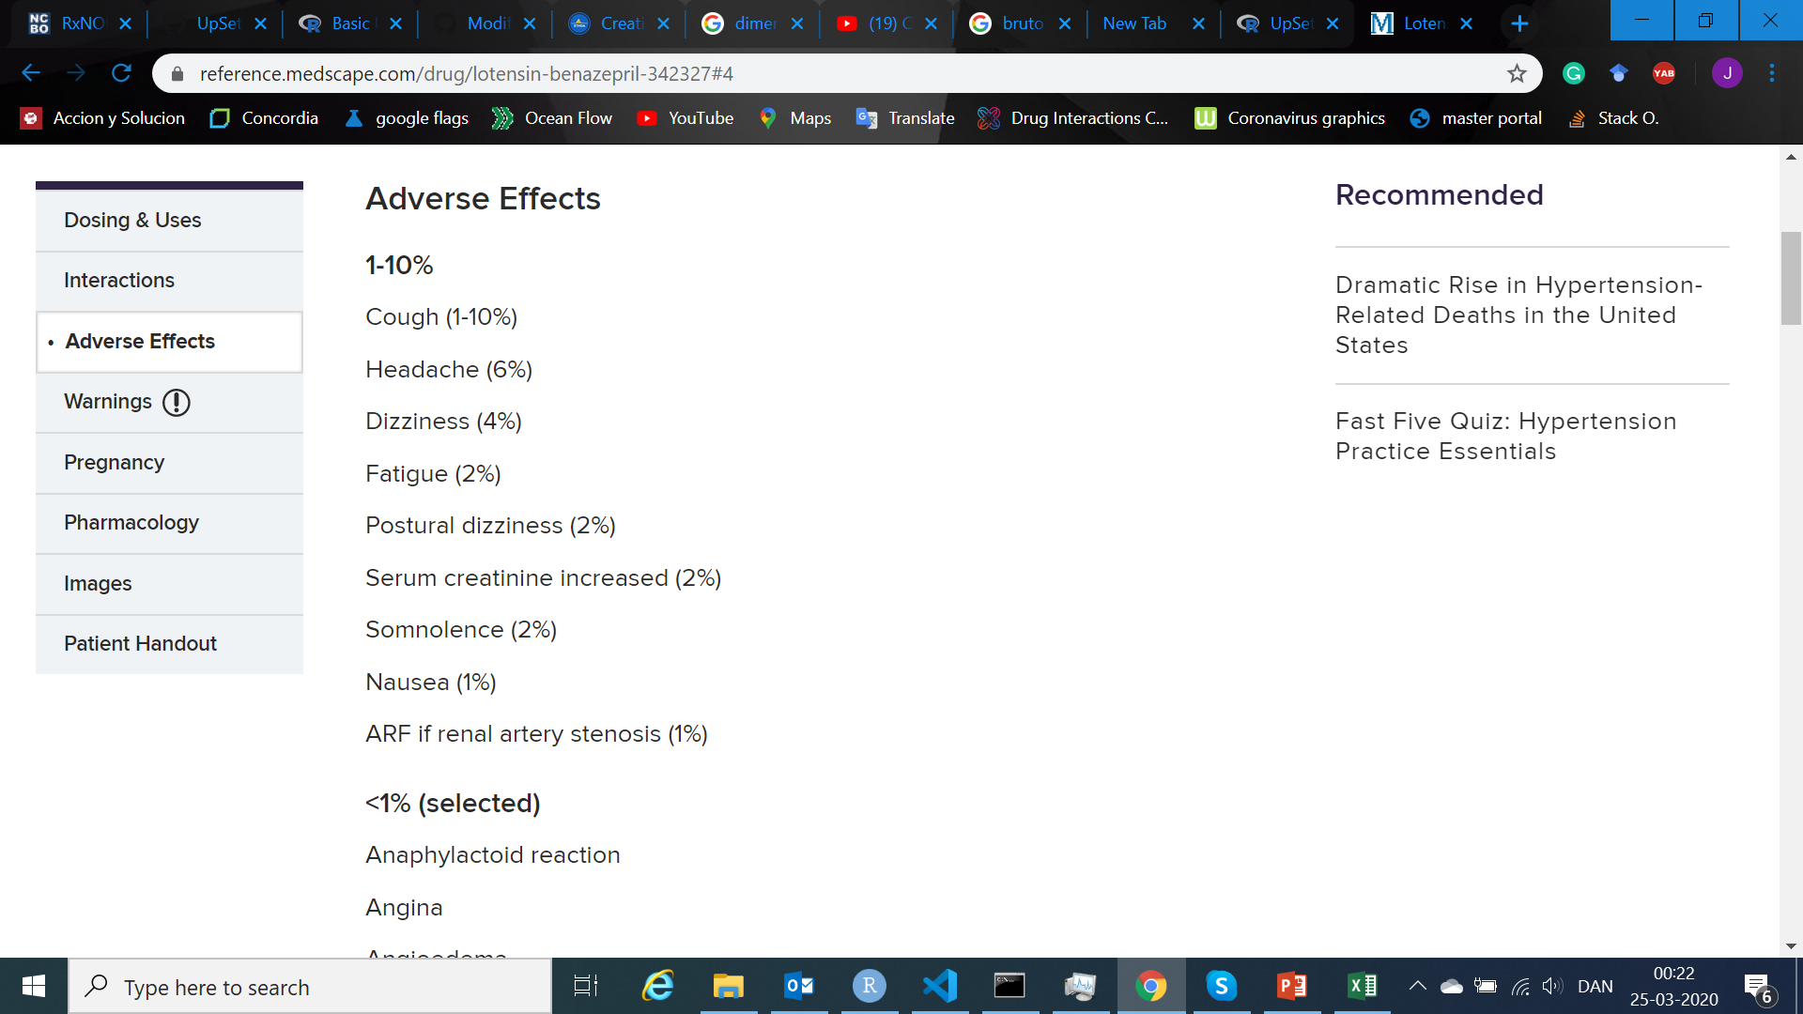
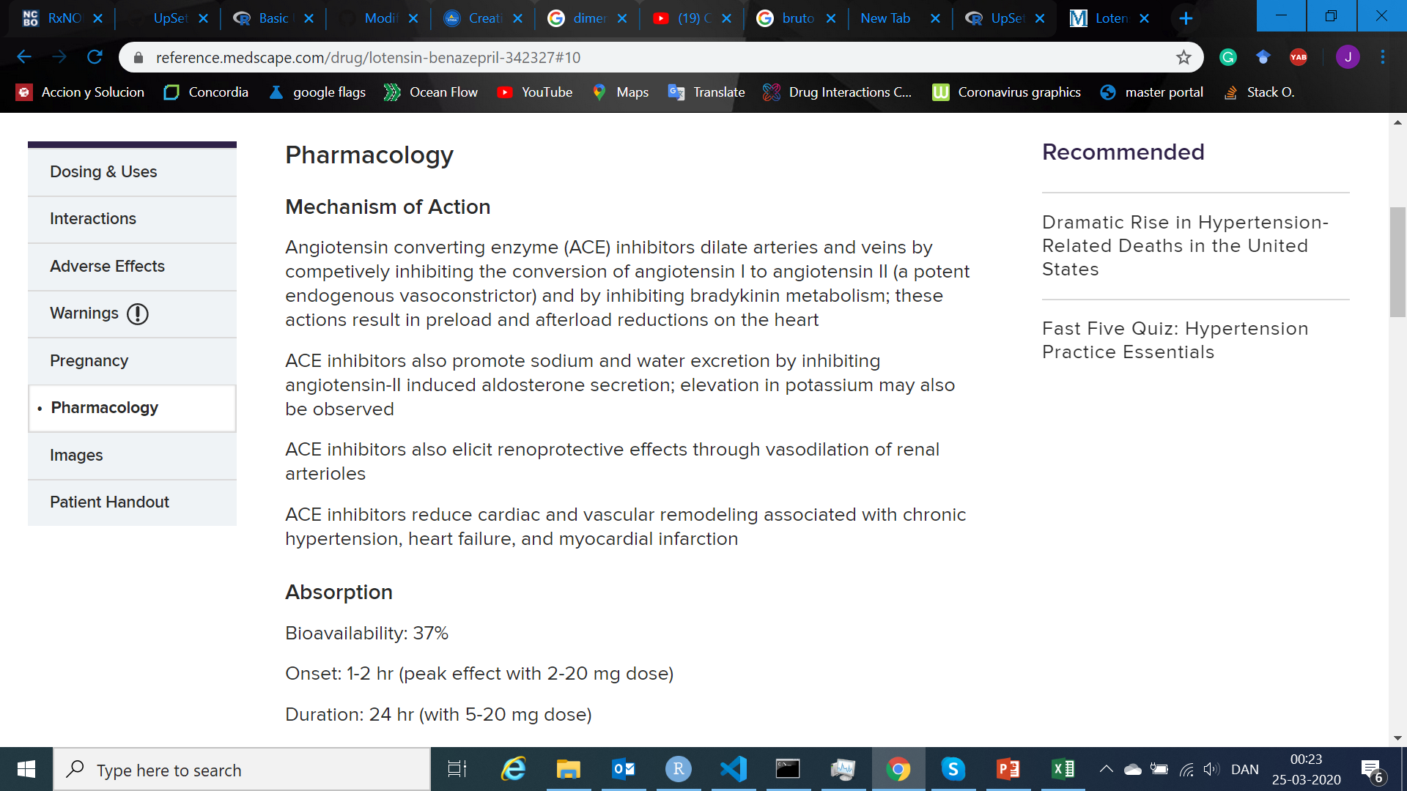
SOME NEW SOURCES; medscape

Slide 11
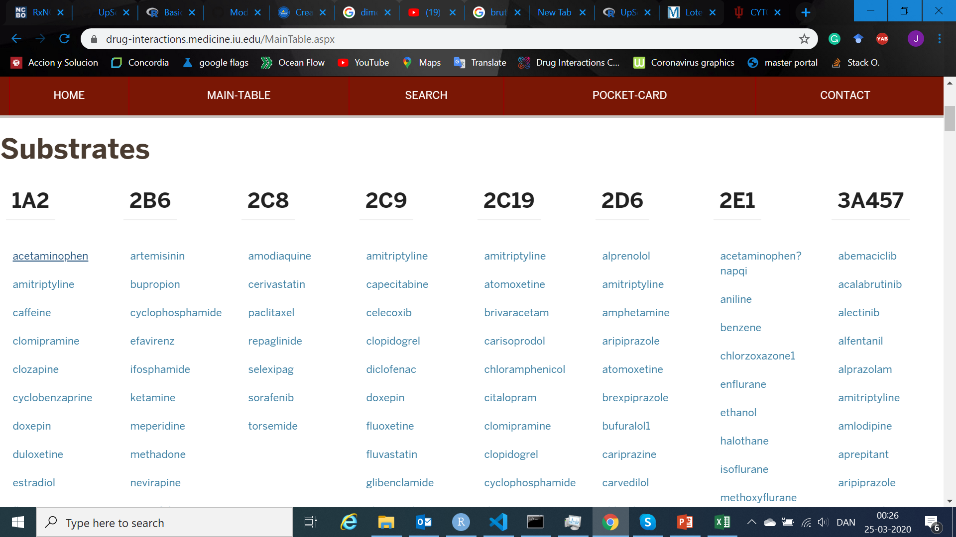
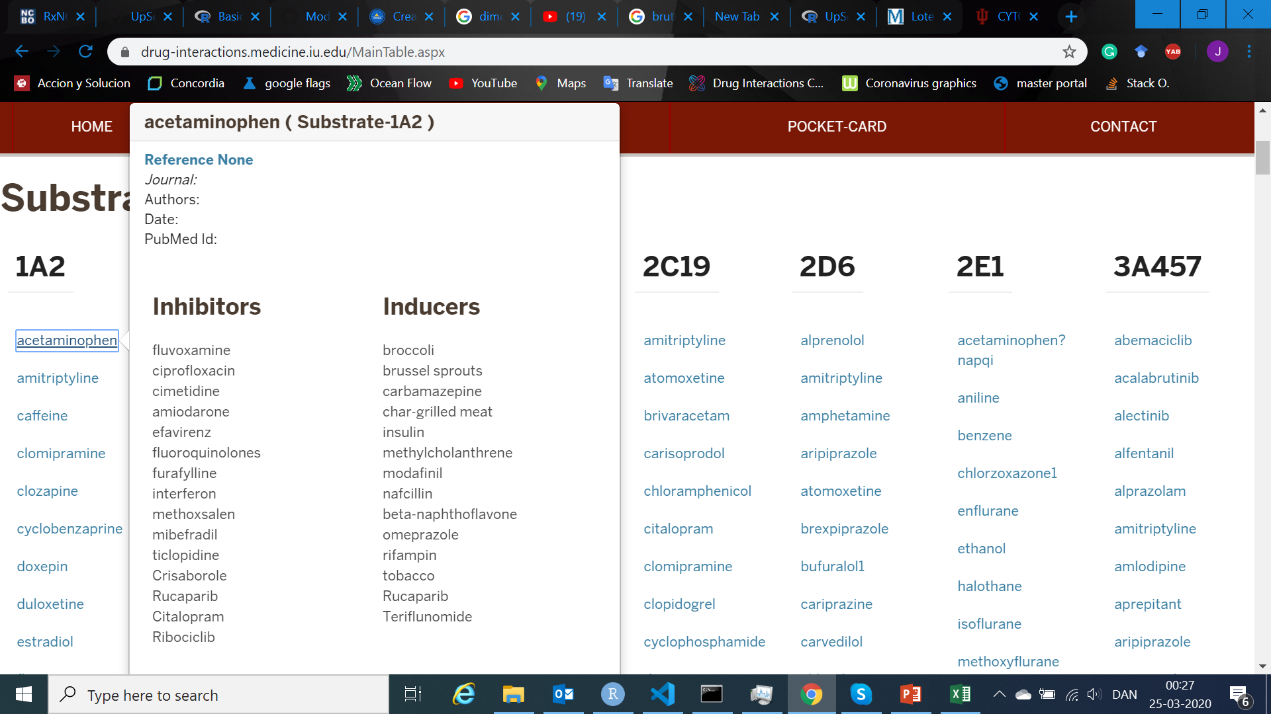
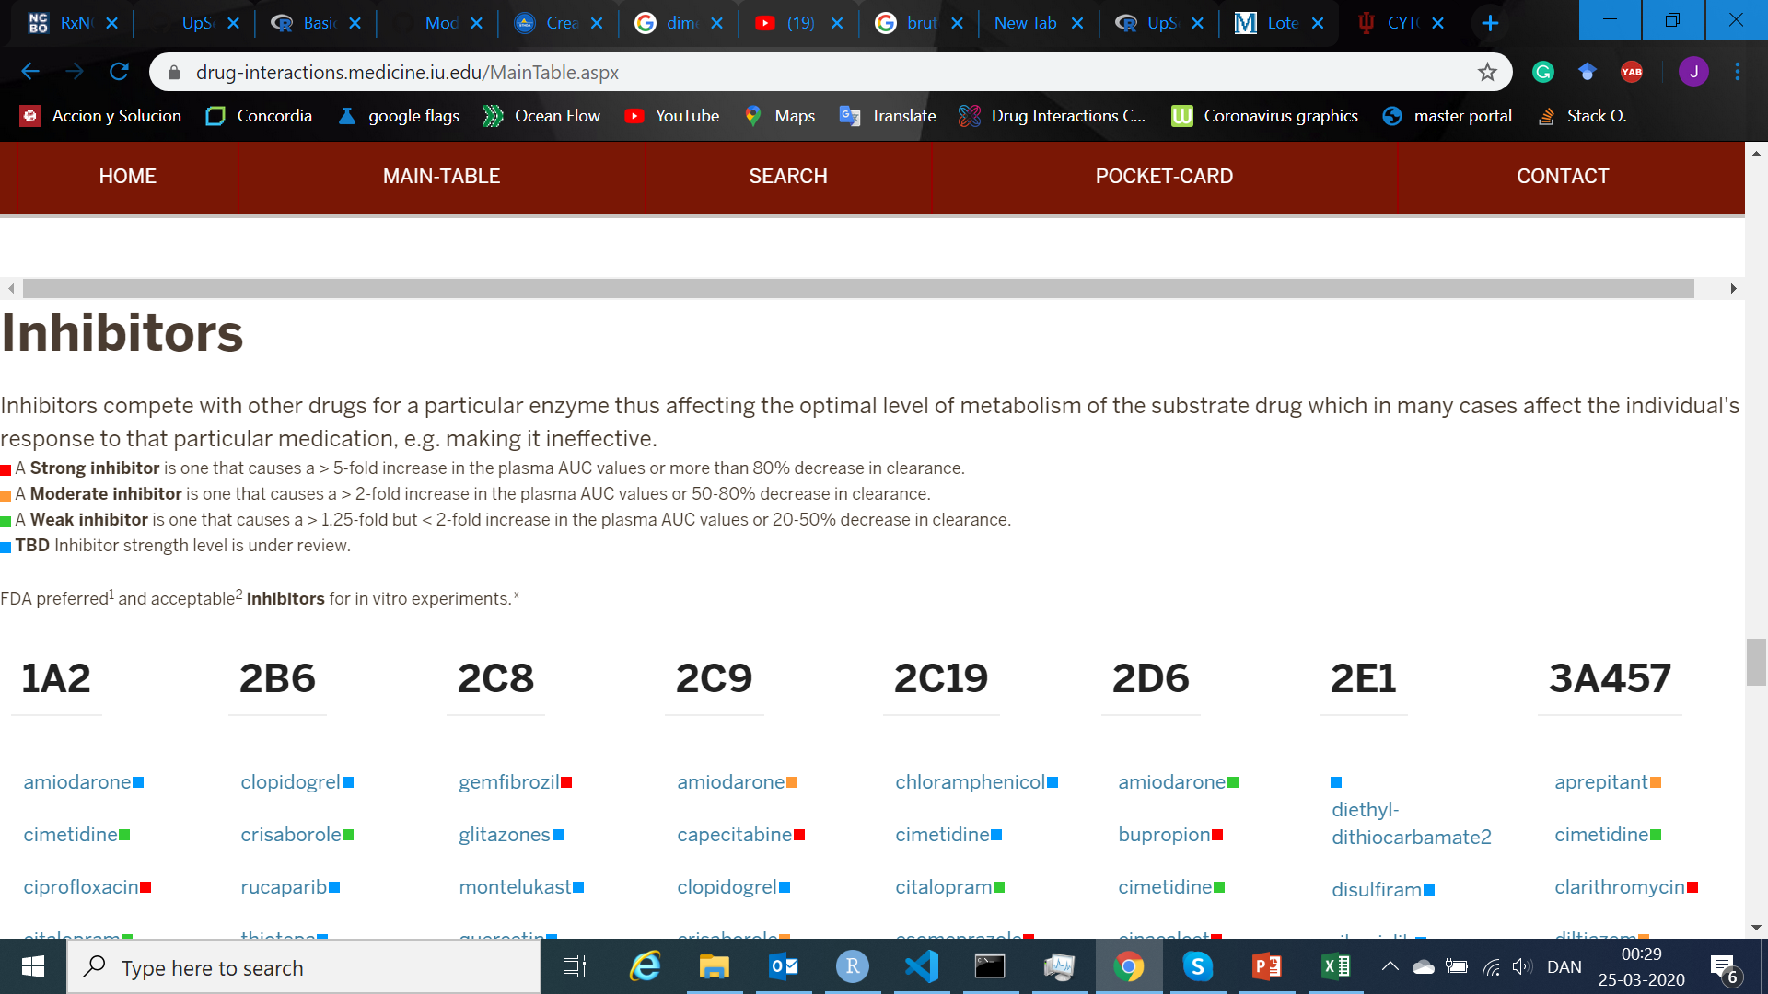
SOME NEW SOURCES; FLOCKCHART TABLE

Slide 12
WHAT’S NEXT?
Continue with the report.
Deal with databases with no identifiers
.
.
.
.
.
.

